Slide 1
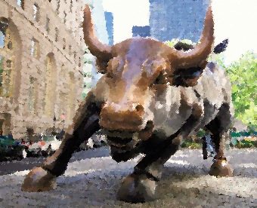
Lecture 1: introduction —what is an investment?
HE Tai-Sen
FINANCIAL ECONOMICS
Notes:
http://news.brown.edu/articles/2017/02/impulse
Suggested readings:
https://scholar.harvard.edu/files/laibson/files/intertemporal_choice.pdf
https://scholar.harvard.edu/files/laibson/files/intertemporal_choice_handbook_vol_2_ericson_laibson.pdf

Slide 2
Introduction
Outline
What is an Investment? The CHEQUE Example
The Discounted Cash Flow (DCF) Model
Course Framework
Course Outline

Slide 3
Introduction
What is an Investment?
Notes:
In economics, time preference determines intertemporal choices, such as saving, investment, and health behaviors.
Good predictor of health-related behavior (obesity/smoking) and saving decisions. (Sutter et al., 2010, AER)
Adolescent Time Preferences Predict Lifetime Outcomes (Golsteyn, Grönqvist, & Lindahl, 2014, EJ)
Impatience and Uncertainty: Experimental Decisions Predict Adolescents’ Field Behavior, Sutter et al. (2013), American Economic Review.

Slide 4
Introduction
What is an Investment?
The CHEQUE example
I write this $100 cheque.
You can cash this cheque a year from now.
I sell the cheque for $90.
Question: How much are you willing to pay for this CHEQUE? Your Answer: $ (It is an open-end question!)
Notes:
In economics, time preference determines intertemporal choices, such as saving, investment, and health behaviors.
Good predictor of health-related behavior (obesity/smoking) and saving decisions. (Sutter et al., 2010, AER)
Adolescent Time Preferences Predict Lifetime Outcomes (Golsteyn, Grönqvist, & Lindahl, 2014, EJ)
Impatience and Uncertainty: Experimental Decisions Predict Adolescents’ Field Behavior, Sutter et al. (2013), American Economic Review.

Slide 5

Introduction
What is an Investment?
Step 1: Identify the cash flows
Step 2: Determine the required rate of return
Risk-free rate
Risk premium
Question: You may wonder whether I ignore the inflation rate? Where is it?
Step 3: Calculate the present value
Here is a youtube video to refresh your memory.
Step 4: Compare your valuation with the price
Notes:
In economics, time preference determines intertemporal choices, such as saving, investment, and health behaviors.
Good predictor of health-related behavior (obesity/smoking) and saving decisions. (Sutter et al., 2010, AER)
Adolescent Time Preferences Predict Lifetime Outcomes (Golsteyn, Grönqvist, & Lindahl, 2014, EJ)
Impatience and Uncertainty: Experimental Decisions Predict Adolescents’ Field Behavior, Sutter et al. (2013), American Economic Review.

Slide 6
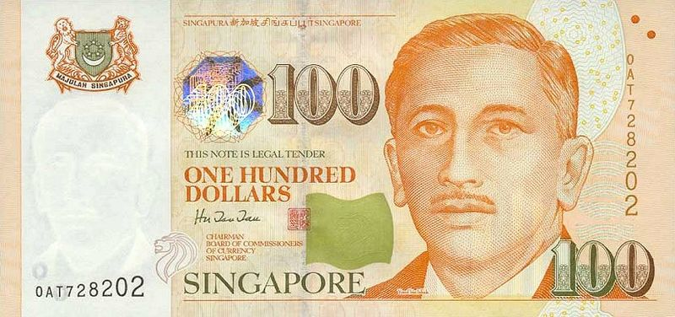
Introduction
What is an Investment?
Future value and compounding
365 days
Suppose the interest rate is 5%
??
100*(1+5%)=105
Notes:
In economics, time preference determines intertemporal choices, such as saving, investment, and health behaviors.
Good predictor of health-related behavior (obesity/smoking) and saving decisions. (Sutter et al., 2010, AER)
Adolescent Time Preferences Predict Lifetime Outcomes (Golsteyn, Grönqvist, & Lindahl, 2014, EJ)
Impatience and Uncertainty: Experimental Decisions Predict Adolescents’ Field Behavior, Sutter et al. (2013), American Economic Review.

Slide 7

Introduction
What is an Investment?
Present value and discounting
365 days
Suppose the interest rate is 5%
??
100/(1+5%)=95.24
Notes:
In economics, time preference determines intertemporal choices, such as saving, investment, and health behaviors.
Good predictor of health-related behavior (obesity/smoking) and saving decisions. (Sutter et al., 2010, AER)
Adolescent Time Preferences Predict Lifetime Outcomes (Golsteyn, Grönqvist, & Lindahl, 2014, EJ)
Impatience and Uncertainty: Experimental Decisions Predict Adolescents’ Field Behavior, Sutter et al. (2013), American Economic Review.

Slide 8
Introduction
What is an Investment?
Suppose the required rate of return is 10%. Please calculate the present value of the $100 cheque.
The valuation ($90.9) is higher than the price ($90).
=>You should buy it.
Notes:
In economics, time preference determines intertemporal choices, such as saving, investment, and health behaviors.
Good predictor of health-related behavior (obesity/smoking) and saving decisions. (Sutter et al., 2010, AER)
Adolescent Time Preferences Predict Lifetime Outcomes (Golsteyn, Grönqvist, & Lindahl, 2014, EJ)
Impatience and Uncertainty: Experimental Decisions Predict Adolescents’ Field Behavior, Sutter et al. (2013), American Economic Review.

Slide 9
Introduction
What is an Investment?
Let’s make the example a bit more complicated. Suppose the required rate of return is still 10%. You receive two $100 cheques. You can cash one check a year from now and the other two years for now. Please calculate the present value of the two $100 cheques.
Notes:
In economics, time preference determines intertemporal choices, such as saving, investment, and health behaviors.
Good predictor of health-related behavior (obesity/smoking) and saving decisions. (Sutter et al., 2010, AER)
Adolescent Time Preferences Predict Lifetime Outcomes (Golsteyn, Grönqvist, & Lindahl, 2014, EJ)
Impatience and Uncertainty: Experimental Decisions Predict Adolescents’ Field Behavior, Sutter et al. (2013), American Economic Review.

Slide 10
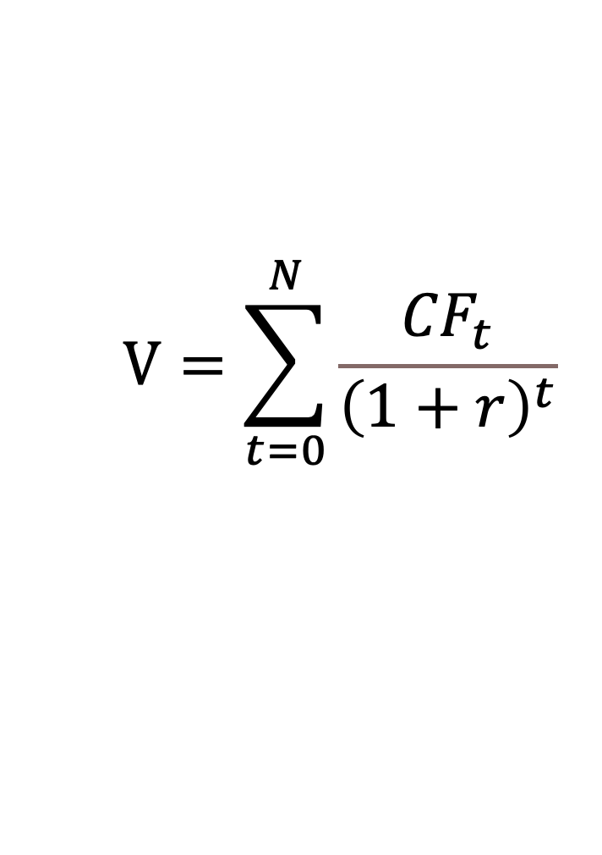
Introduction
What is an Investment?
……
N periods
$$V=\sum_{t=0}^{N}{\frac{{CF}_{t}}{{\left(1+r\right)}^{t}}}$$
The Discounted Cash Flow Model
Notes:
In economics, time preference determines intertemporal choices, such as saving, investment, and health behaviors.
Good predictor of health-related behavior (obesity/smoking) and saving decisions. (Sutter et al., 2010, AER)
Adolescent Time Preferences Predict Lifetime Outcomes (Golsteyn, Grönqvist, & Lindahl, 2014, EJ)
Impatience and Uncertainty: Experimental Decisions Predict Adolescents’ Field Behavior, Sutter et al. (2013), American Economic Review.

Slide 11
Introduction
The Discounted Cash Flow Model
How does the CHEQUE example relate to the investments in the real world?
Think about a share of stock, a government bond, a condo for rent, and even your college education …. How do they resemble the CHEQUE example?
Notes:
In economics, time preference determines intertemporal choices, such as saving, investment, and health behaviors.
Good predictor of health-related behavior (obesity/smoking) and saving decisions. (Sutter et al., 2010, AER)
Adolescent Time Preferences Predict Lifetime Outcomes (Golsteyn, Grönqvist, & Lindahl, 2014, EJ)
Impatience and Uncertainty: Experimental Decisions Predict Adolescents’ Field Behavior, Sutter et al. (2013), American Economic Review.

Slide 12
Introduction
The Discounted Cash Flow Model
You can see these investments as streams of CHEQUEs.
So, you can now use the DCF model to EVALUATE these investments.
FOUR STEPS:
1. Identify the cash flow(s)
2. Determine an appropriate required rate of return
3. Calculate the present value
4. Compare your valuation with the price
Notes:
In economics, time preference determines intertemporal choices, such as saving, investment, and health behaviors.
Good predictor of health-related behavior (obesity/smoking) and saving decisions. (Sutter et al., 2010, AER)
Adolescent Time Preferences Predict Lifetime Outcomes (Golsteyn, Grönqvist, & Lindahl, 2014, EJ)
Impatience and Uncertainty: Experimental Decisions Predict Adolescents’ Field Behavior, Sutter et al. (2013), American Economic Review.

Slide 13
Introduction
The Discounted Cash Flow Model
Is it really that simple? Certainly not.
Now, suppose you want to evaluate a stock:
Cash flows ?
Risk premium ?
Market Price(P) = Intrinsic Value(V) ?
Notes:
In economics, time preference determines intertemporal choices, such as saving, investment, and health behaviors.
Good predictor of health-related behavior (obesity/smoking) and saving decisions. (Sutter et al., 2010, AER)
Adolescent Time Preferences Predict Lifetime Outcomes (Golsteyn, Grönqvist, & Lindahl, 2014, EJ)
Impatience and Uncertainty: Experimental Decisions Predict Adolescents’ Field Behavior, Sutter et al. (2013), American Economic Review.

Slide 14
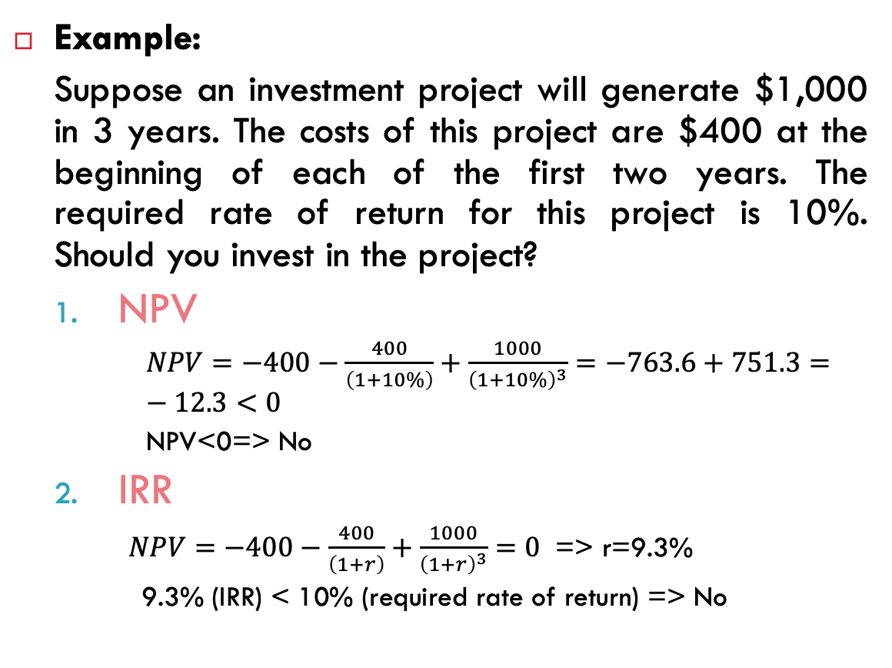
Introduction
The Discounted Cash Flow Model
Two capital budgeting techniques:
Net Present Value (NPV): the present value of cash inflows - the present value of cash outflows
Investment rule: Invest if NPV>0
Internal rate of return (IRR): the interest rate that makes NPV=0
Investment rule: Invest if IRR>required rate of return
Example:
Suppose an investment project will generate $1,000 in 3 years. The costs of this project are $400 at the beginning of each of the first two years. The required rate of return for this project is 10%. Should you invest in the project?
NPV
$NPV=−400−\frac{400}{\left(1+10\%\right)}+\frac{1000}{{\left(1+10\%\right)}^{3}}=−763.6+751.3=−12.3<0$
NPV<0=> No
IRR
$NPV=−400−\frac{400}{\left(1+r\right)}+\frac{1000}{{\left(1+r\right)}^{3}}=0$ => r=9.3%
9.3% (IRR) < 10% (required rate of return) => No
Notes:
In economics, time preference determines intertemporal choices, such as saving, investment, and health behaviors.
Good predictor of health-related behavior (obesity/smoking) and saving decisions. (Sutter et al., 2010, AER)
Adolescent Time Preferences Predict Lifetime Outcomes (Golsteyn, Grönqvist, & Lindahl, 2014, EJ)
Impatience and Uncertainty: Experimental Decisions Predict Adolescents’ Field Behavior, Sutter et al. (2013), American Economic Review.

Slide 15
Introduction
Course Framework
This module consists of four major parts:
Part 1: Financial System and Instruments (Ch1-4)
Financial System and Financial Instruments
How Securities are Traded and Mutual Funds
Part 2: Portfolio Theory (Ch 5-7)
Suppose you have one million dollars. How would you allocate it into different asset categories?
Risk Aversion and Capital Allocation
Optimal Risky Portfolio
Part 3: Security Analysis (Ch 14-15, 18)
Stock Valuation
Bond Valuation
Part 4: Equilibrium in Capital Markets (Ch 9, 11-12)
Capital Asset Pricing Model
Market Efficiency
Behavioral Finance
Notes:
In economics, time preference determines intertemporal choices, such as saving, investment, and health behaviors.
Good predictor of health-related behavior (obesity/smoking) and saving decisions. (Sutter et al., 2010, AER)
Adolescent Time Preferences Predict Lifetime Outcomes (Golsteyn, Grönqvist, & Lindahl, 2014, EJ)
Impatience and Uncertainty: Experimental Decisions Predict Adolescents’ Field Behavior, Sutter et al. (2013), American Economic Review.

Slide 16

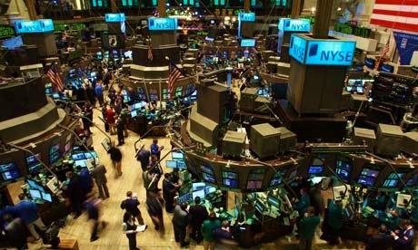
Introduction
Course Outline
What should I buy???
After taking this module, you will have developed financial intuition that will give you the confidence to make well-informed investment decisions in your life.
Notes:
In economics, time preference determines intertemporal choices, such as saving, investment, and health behaviors.
Good predictor of health-related behavior (obesity/smoking) and saving decisions. (Sutter et al., 2010, AER)
Adolescent Time Preferences Predict Lifetime Outcomes (Golsteyn, Grönqvist, & Lindahl, 2014, EJ)
Impatience and Uncertainty: Experimental Decisions Predict Adolescents’ Field Behavior, Sutter et al. (2013), American Economic Review.

Slide 17
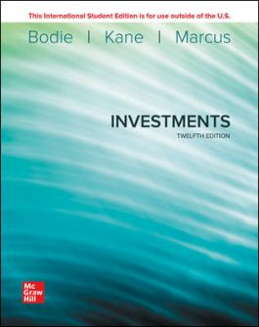
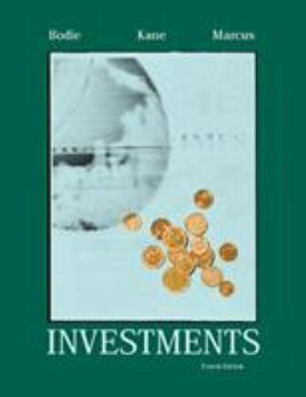
Introduction
Course Outline
Textbook:
ISE Investments, 12th Edition. Zvi Bodie, Alex Kane, and Alan J. Marcus. (2020). Please feel free to use an earlier edition of this textbook (e.g., Investments, Asia Global Edition. 2013. Zvi Bodie, Alex Kane, Alan J. Marcus, and Ravi Jain).
Notes:
In economics, time preference determines intertemporal choices, such as saving, investment, and health behaviors.
Good predictor of health-related behavior (obesity/smoking) and saving decisions. (Sutter et al., 2010, AER)
Adolescent Time Preferences Predict Lifetime Outcomes (Golsteyn, Grönqvist, & Lindahl, 2014, EJ)
Impatience and Uncertainty: Experimental Decisions Predict Adolescents’ Field Behavior, Sutter et al. (2013), American Economic Review.

Slide 18
Introduction
Course Outline
Lecture (2 hr)+Tutorial (1 hr)
Grading:
Coursework (40%)
Participation (15% - 25%)
Midterm Quiz (15% - 25%)
Final Exam (60%)
Notes:
In economics, time preference determines intertemporal choices, such as saving, investment, and health behaviors.
Good predictor of health-related behavior (obesity/smoking) and saving decisions. (Sutter et al., 2010, AER)
Adolescent Time Preferences Predict Lifetime Outcomes (Golsteyn, Grönqvist, & Lindahl, 2014, EJ)
Impatience and Uncertainty: Experimental Decisions Predict Adolescents’ Field Behavior, Sutter et al. (2013), American Economic Review.

Slide 19
Introduction
Exit Survey
Please fill in the exit survey before you leave:
https://forms.gle/CQZ8HDaBs8cu2kmi8
What Finance/Accounting modules have you taken?
Do you have any experience in investing (stocks, bonds, mutual funds, etc.)?
Why do you want to take this module?
What do you expect to learn from this module?
Five Financial Literacy Questions
Notes:
In economics, time preference determines intertemporal choices, such as saving, investment, and health behaviors.
Good predictor of health-related behavior (obesity/smoking) and saving decisions. (Sutter et al., 2010, AER)
Adolescent Time Preferences Predict Lifetime Outcomes (Golsteyn, Grönqvist, & Lindahl, 2014, EJ)
Impatience and Uncertainty: Experimental Decisions Predict Adolescents’ Field Behavior, Sutter et al. (2013), American Economic Review.

